Slide 1


Commercial Analysis
Final Presentation

Slide 2


Dashboard Enhancements
Post mid term presentation to the sponsor, we made the following changes/additions to our dashboards as per feedback
Pareto Analysis
Licensing
Host Behavior
We have added dropdown options for users to be able to select a metric of their choice for visualization.
Metrics:
Host vs Revenue
Host vs Listing
To give a better view of what major commercial players look like across countries, we curated a list of host names that represent a management company.
We created a licensing dashboard that has drill down functionality upto the city level
** Keeping in mind the relation between various metrics, we changed the color tones across dashboards. Used monochromatic colors for better visualization.

Slide 3


Final Dashboards
Mid-term (USA only)
National-level Overview
State-level Overview
State-level Commercial Segmentation
County-level Commercial Segmentation
County-level Licensing
Pareto Analysis
State-level Host Behavior
State-level Host Profile
Final (USA & Australia)
Executive Summary
State-level Overview
State-level Commercial Segmentation
County-level Commercial Segmentation
City-level Licensing
Pareto Analysis
State-level Host Behavior
National-level Host Profile
After incorporating feedback

Slide 4
DASHBOARDS
COUNTRY - STATE - COUNTY - CITY LEVEL

Slide 5
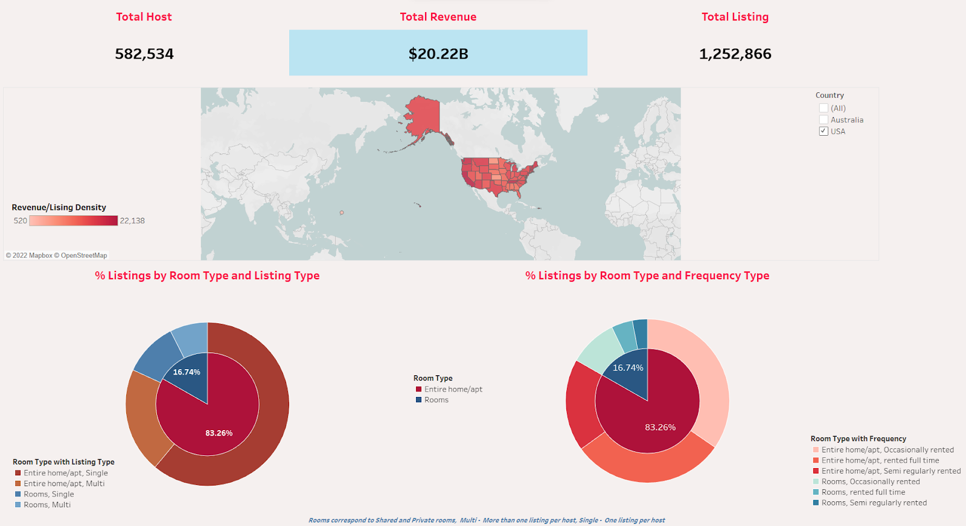
Executive Summary
This dashboard provides a national level overview for both the countries - USA & Australia.
The user can choose to look at statistics of a particular country using the country filter.
Metrics showcased on the dashboard:
Total Hosts in the past year
Total Revenue in the past year
Total Listings in the past year
% Listings by Room type & Listing type
% Listings by Room type & Frequency type

Slide 6
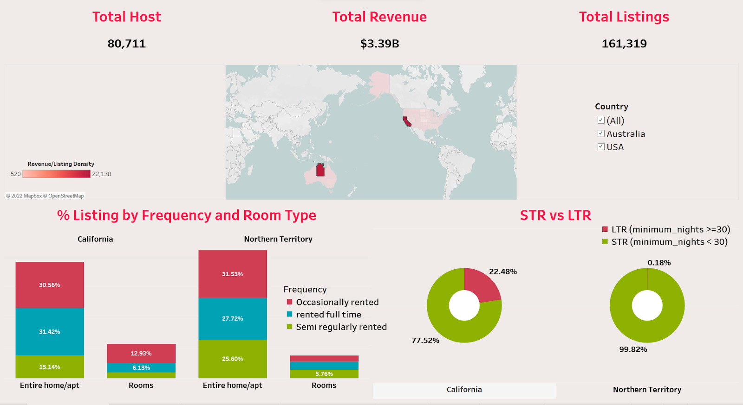
State-level comparison of Listing Types
Ability to drill down to State-level
Capability to compare two different states across metrics
Average Revenue per listing represented through choropleth map : Darker colors corresponding to higher revenue

Slide 7
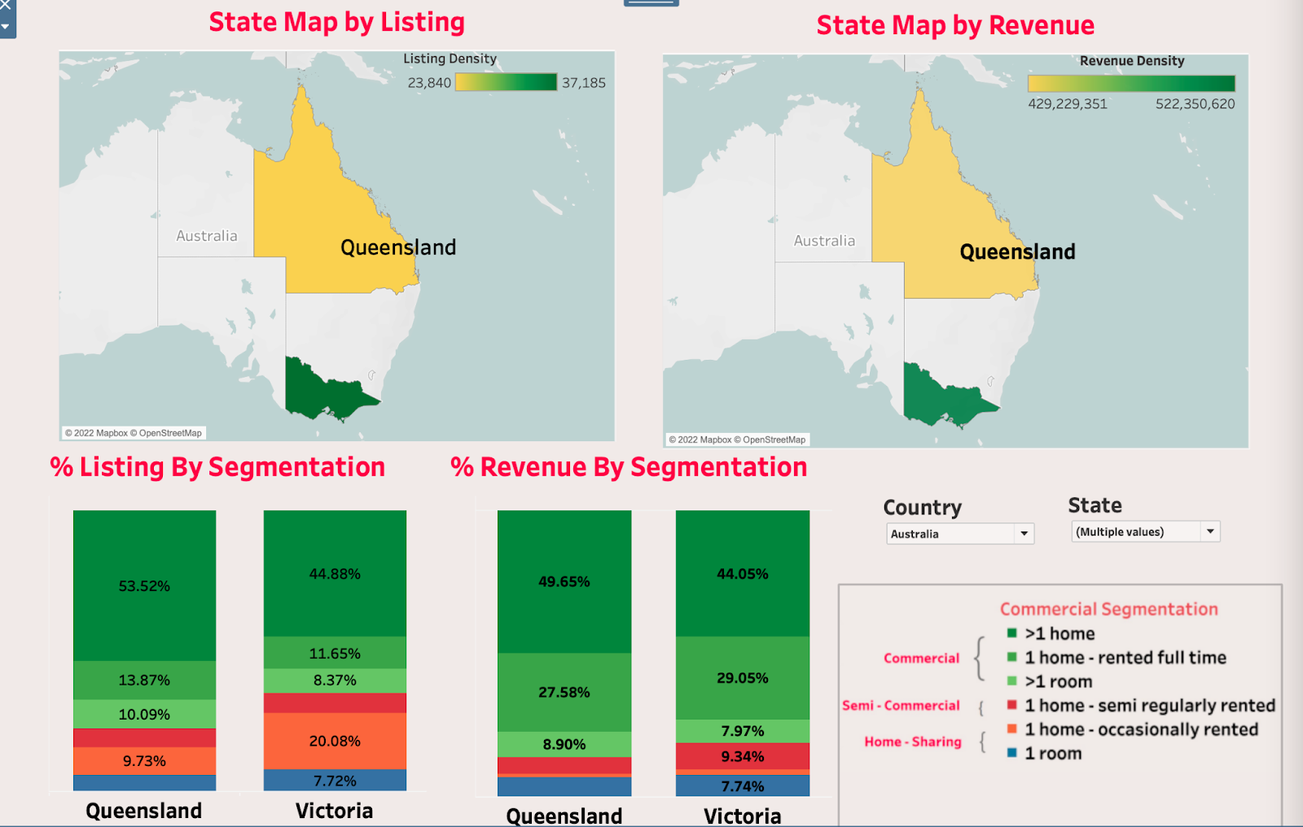
Which states have commercial listings?
Commercial Segmentation differentiates listings that are :
commercial (>1 home/ >1 room/1 home –rented full time)
semi-commercial (1 home- semi regularly rented)
home-sharing (1 room/ 1 room - occasionally rented)
State-level comparison of two metrics :
% Listings by segmentation &
% Revenue by segmentation

Slide 8
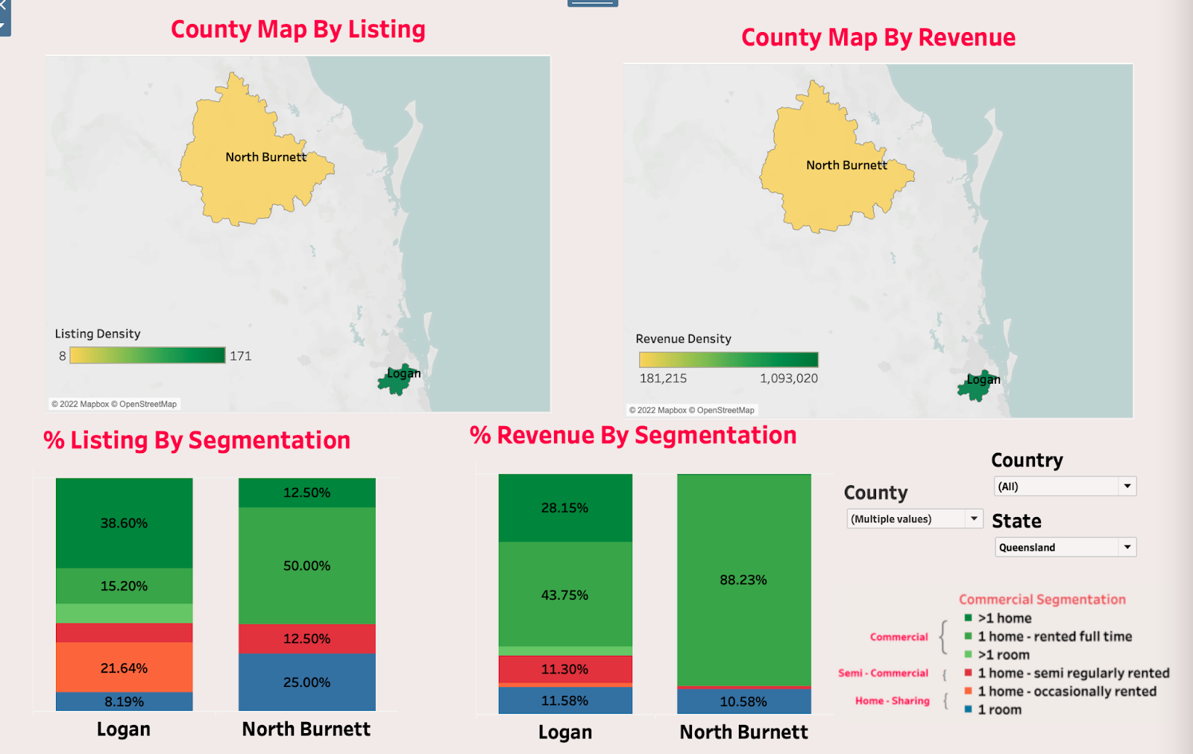
Commercialization at county level
Provides granularity up to the county level
Provides the ability to compare two or more counties against commercial listings and revenue
Colors on the map represent Listing and Revenue Density

Slide 9
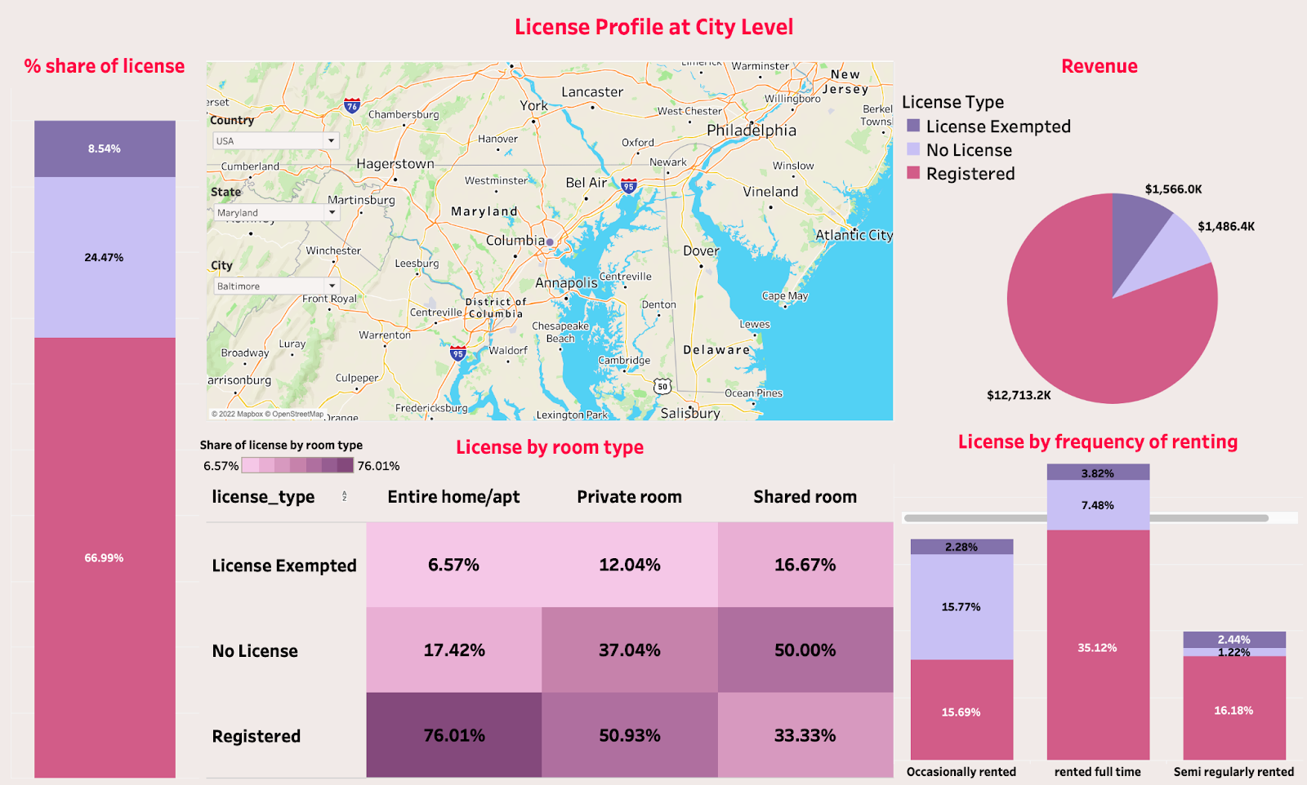
Which cities have licensing requirements?
Depicts four license types:
License Exempted, License Pending, Registered and No License (No data or not registered)
Provides the ability to look at various licensing metrics across individual states and cities by room type and frequency of renting

Slide 10
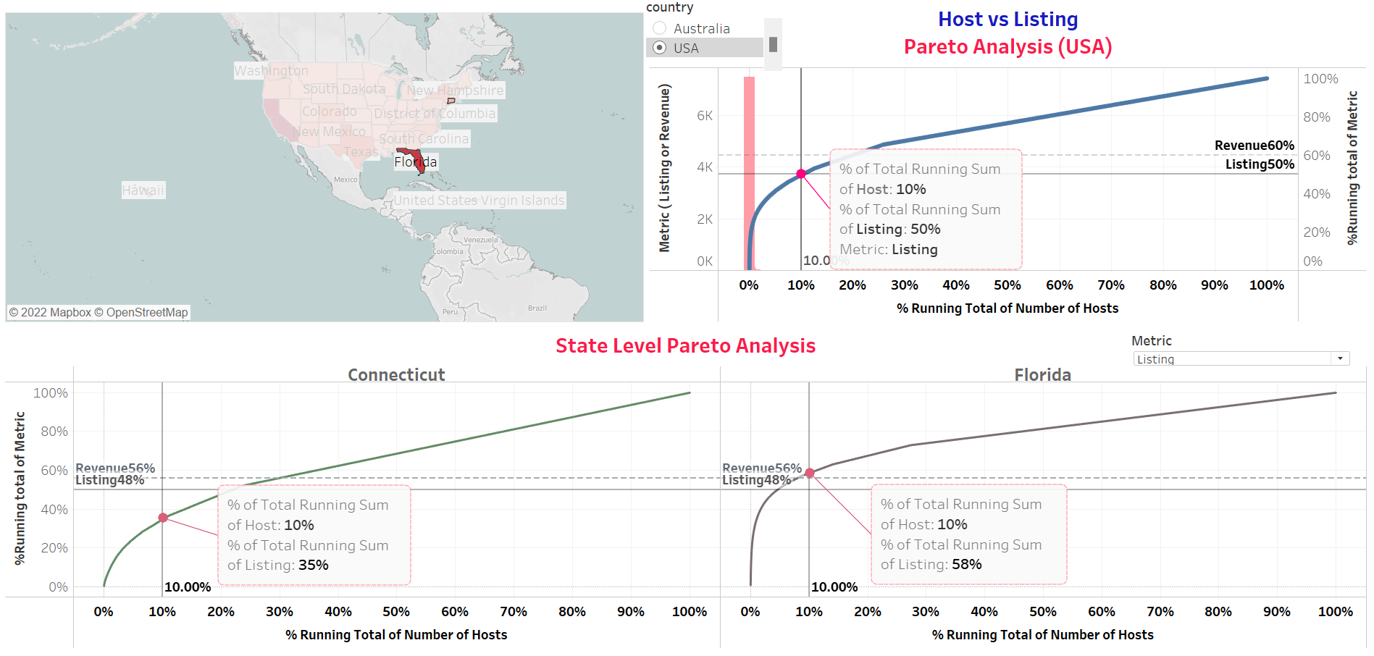
How many listings and how much revenue
do top hosts generate in Airbnb? (USA)
Pareto Analysis: Top 10% of Airbnb hosts in the United States seem to make up 50% of the total listings
This dashboard provides the functionality of drilling down to states to compare the % listings between states
Additionally, user has the ability to select between metrics –
Host vs Revenue and
Host vs Listing

Slide 11
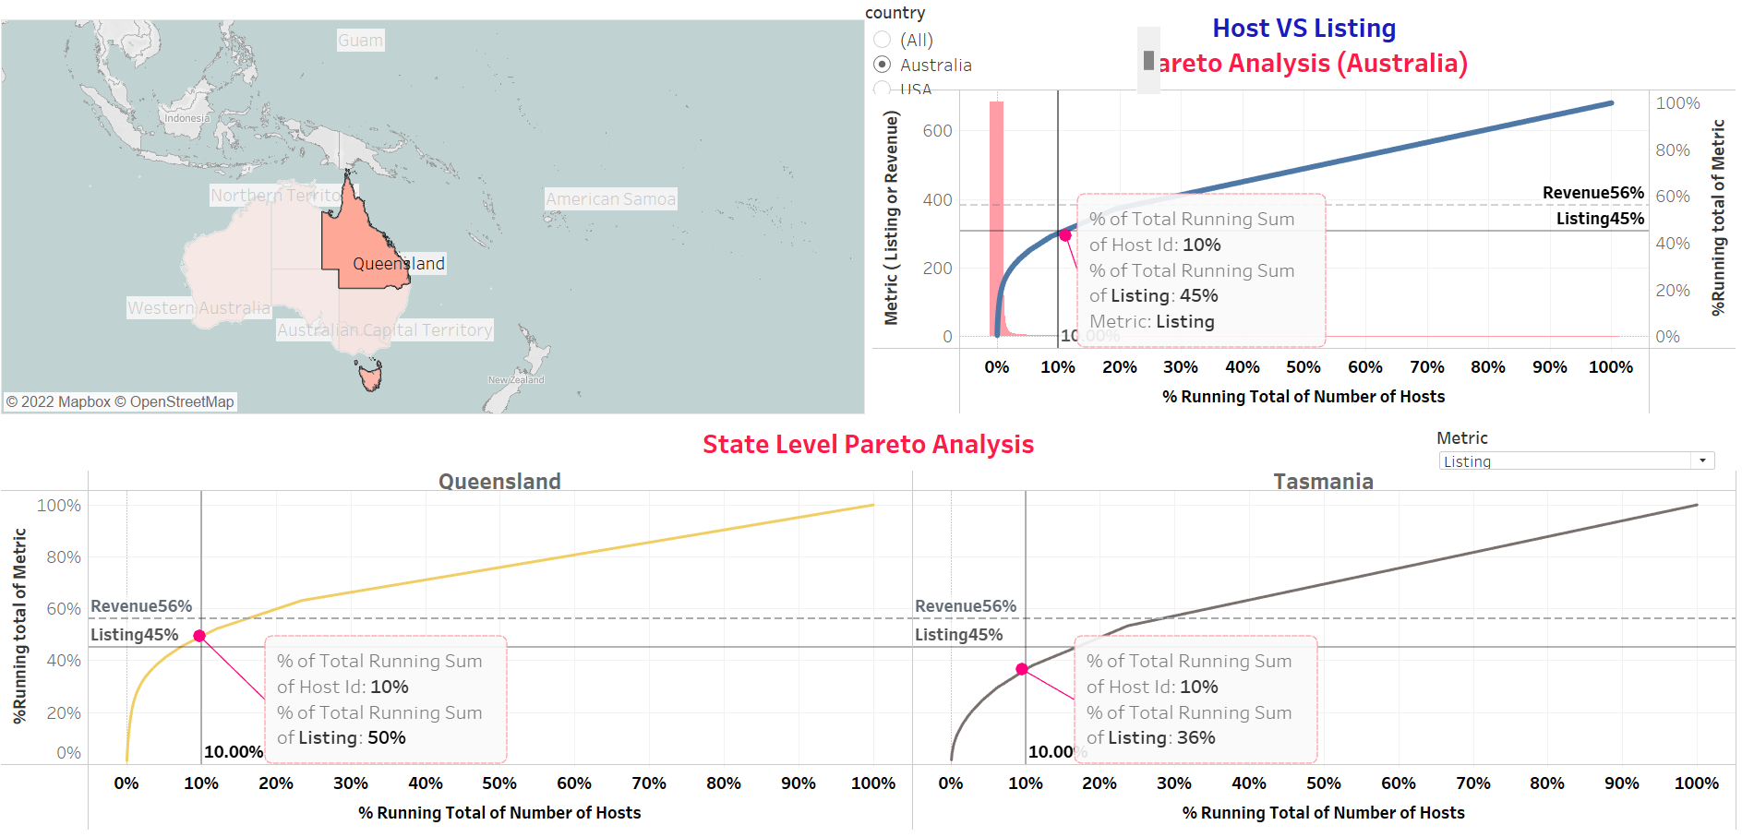
How many listings and how much revenue
do top hosts generate in Airbnb? (AUS)
Pareto Analysis: Top 10% of Airbnb hosts in Australia seem to make up 45% of the total listings
This dashboard provides the functionality of drilling down to states to compare the % listings between states
Additionally, user has the ability to select between metrics –
Host vs Revenue and
Host vs Listing

Slide 12
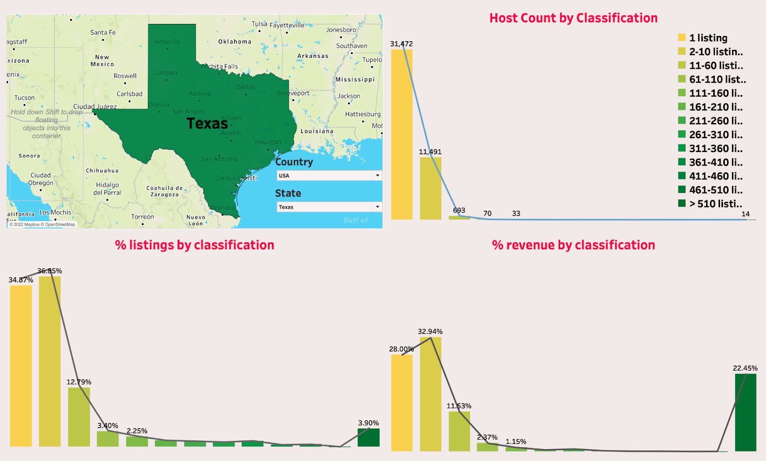
Which are the most commercial states?
Classified hosts into 13 groups according to the number of listings
Filter provides option to choose different states in different countries
Metrics showcased include:
% listings by classification
% revenue by classification

Slide 13
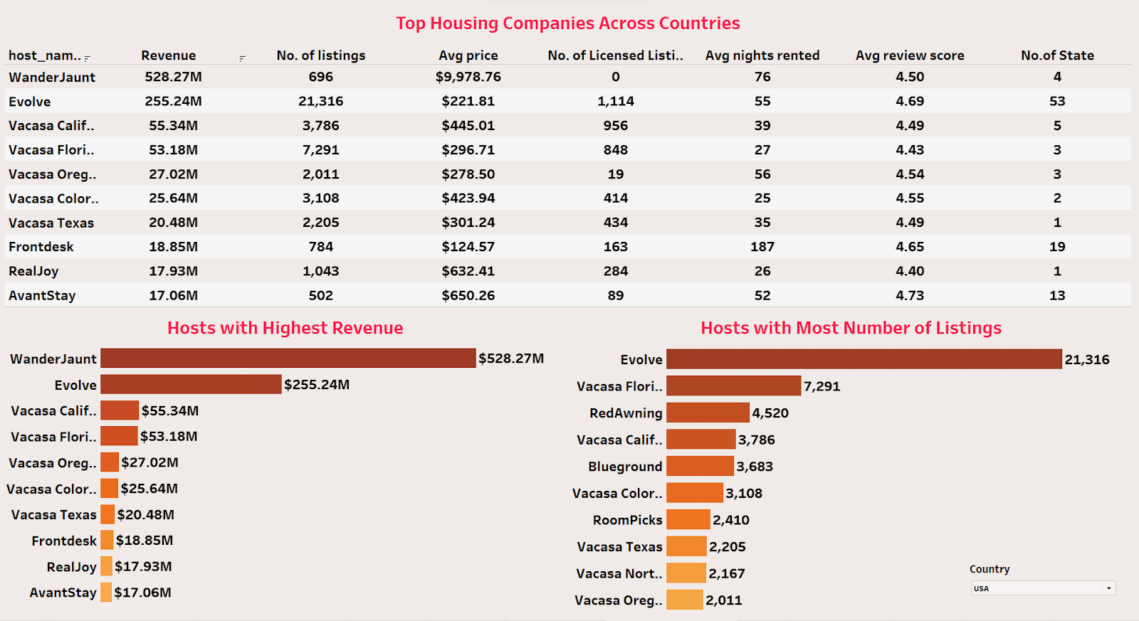
Top 10 Commercial Hosts by Revenue & Listings
This dashboard shows a state-wise overview of the top 10 hosts according to revenue & no of listings
Insightful information regarding Top 10 hosts by revenue

Slide 14
APPENDIX (Enlarged Images of all dashboards & calculations)

Slide 24
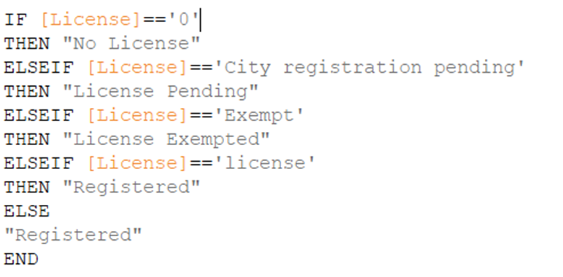
License column Calculation

Slide 25
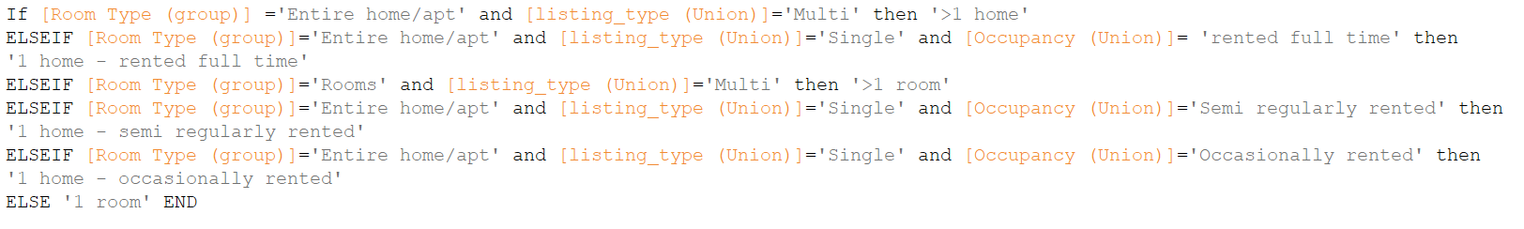
Commercial Segmentation Calculation

Slide 26
Thank you!

